Slide 1
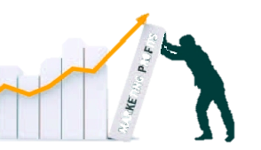

Market Segmentation
and Segmentation Strategies
MBM6
Chapter 5
Understanding Market Segments
Chapter 5 Objectives
Needs-Based Market Segmentation
Building Needs-Based Market Segments
Market Segmentation Strategies
Why would market segmentation help with a business’s customer focus and spend their marketing and sales dollars more efficiently?
Copyright Roger J. Best, 2012

Slide 2
Market Segmentation
and Segmentation Strategies
MBM6
Chapter 5
Needs-Based Market
Segmentation
In this section we will focus on needs-based segmentation and why customer needs should be the first step in the process.
Copyright Roger J. Best, 2012

Slide 3
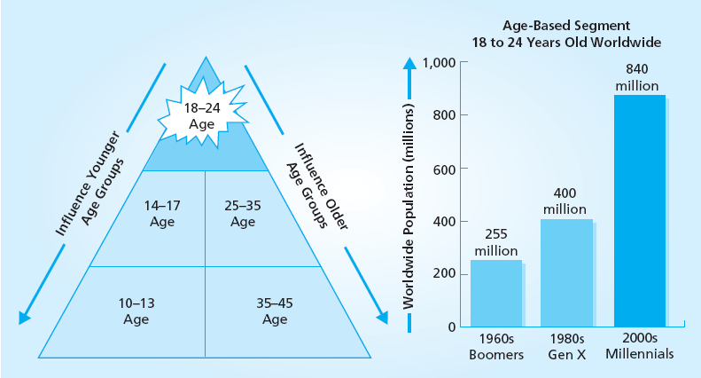
The Millennials Segment
MBM6
Chapter 5
Millennials is a needs-based segment defined by age (18-24). View this video to better understand this segment: We All Want To Be Young, http://vimeo.com/16638983
Why should this segment important to marketers of consumer products such as sunglasses, clothing, and food preferences?
Copyright Roger J. Best, 2012

Slide 4
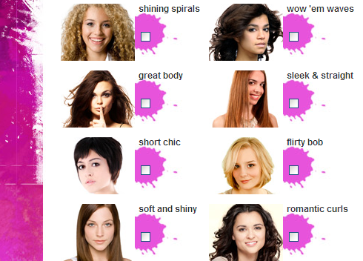
Companies Targeting Millennials
MBM6
Chapter 5
P&G -Herbal Essences repositioned an aging mass-market brand to appeal to socially active young adult women 20-35.
Target has geared its message by focusing on affordable prices, stylish products, and socially correct values. One ad features two college roommates dancing and decorating their dorm room with Target products…“Happy together, design together, save together.”
Grape Nuts’ advertising and its Web site reflect the Gen Y theme of “give it to me straight but don't bore me.”
Recognized Brands include:
Apple
Scion
Converse
Facebook
Red Bull
Jamba Juice
Herbal Essences
Target
Grape Nuts
Copyright Roger J. Best, 2012

Slide 5

Toyota Targeting Millennials
MBM6
Chapter 5
Toyota is launching a TV campaign for the Yaris model featuring singer Gaz Coombes.
Copyright Roger J. Best, 2012

Slide 6
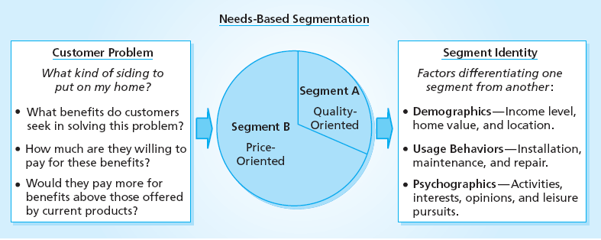


Customer Needs & Customer Identity
MBM6
Chapter 5
Segment B
Segment A
How do customer needs correspond with differences in customer demographics?
Copyright Roger J. Best, 2012

Slide 7
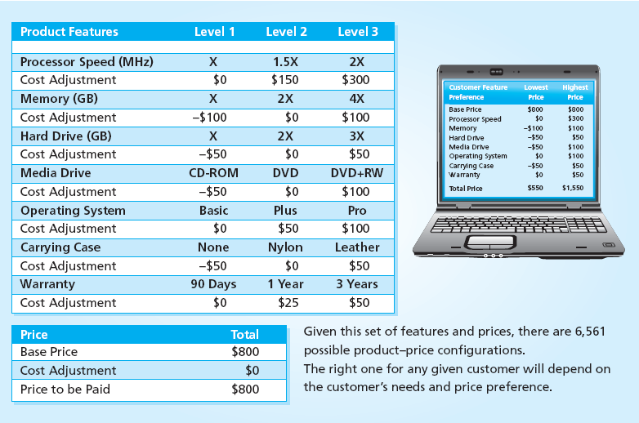
PC Customer Needs & Price
Marketing Performance Tool 5.1
Why would different customers select different options?
Copyright Roger J. Best, 2012

Slide 8
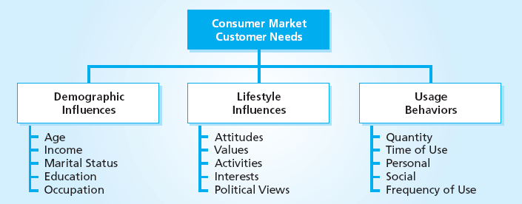



What Drives Customer Needs?
Marketing Performance Tool 5.2
Copyright Roger J. Best, 2012

Slide 9
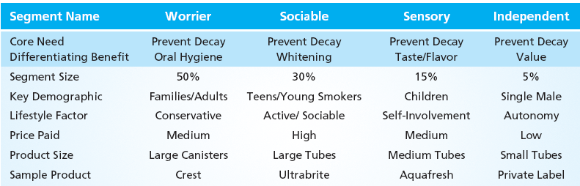



Toothpaste – Needs-Based Segments
Marketing Performance Tool 5.4
Copyright Roger J. Best, 2012

Slide 10
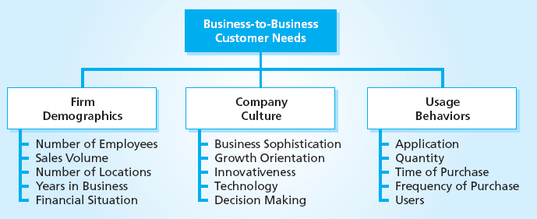
Business Customer Needs
MBM6
Chapter 5
Industrial, commercial and hi-tech customers needs are also shaped by company demographics, company culture and usage behaviors.
Copyright Roger J. Best, 2012

Slide 11
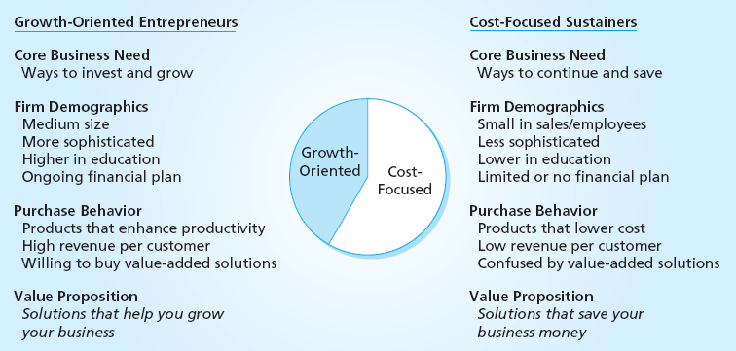


Small Business Market Segments
MBM6
Chapter 5
Growth-Oriented
Cost-Focused
Copyright Roger J. Best, 2012

Slide 12
Market Segmentation
and Segmentation Strategies
MBM6
Chapter 5
Building Needs-Based Market Segments
In this section we will focus on how to build a needs-based market segment.
Copyright Roger J. Best, 2012

Slide 13
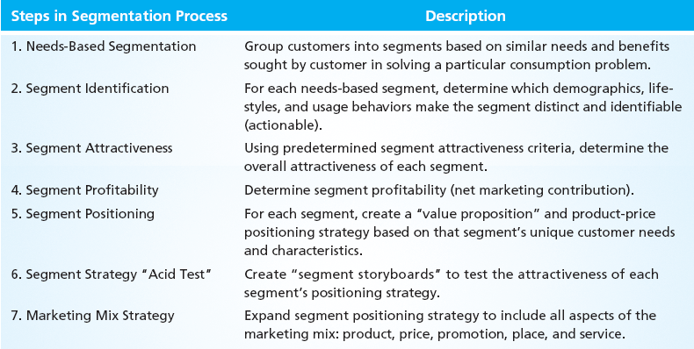
The Segmentation Process
MBM6
Chapter 5
Why is it important to start the process with customer needs?
Copyright Roger J. Best, 2011

Slide 14
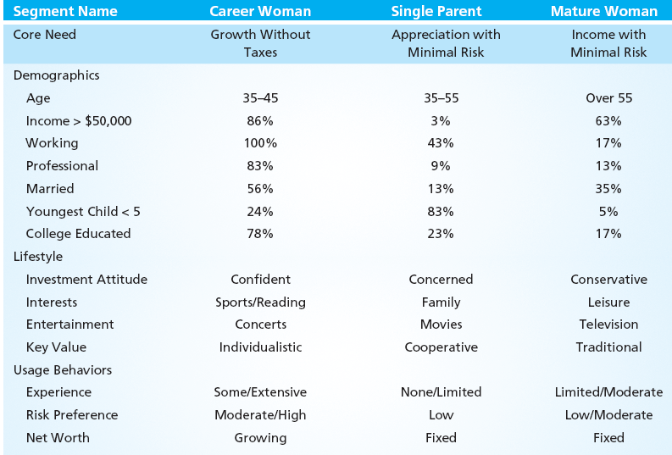
Steps 1 & 2 - Segment Core Needs and Segment Identification
MBM6
Chapter 5
Copyright Roger J. Best, 2011

Slide 15
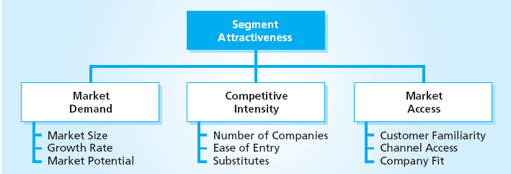
Step 3 – Segment Attractiveness
MBM6
Chapter 5
Segment attractiveness can vary from one segment to another based on market demand, competitive intensity and access to customers.
Copyright Roger J. Best, 2011

Slide 16
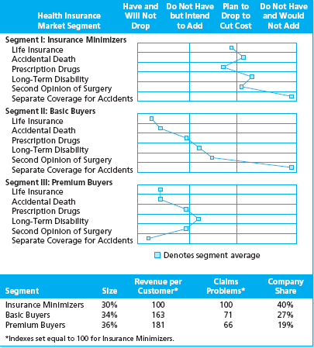

Market Segment Profile
MBM6
Chapter 5
Health Insurance Company
How would this market segmentation help this company improve sales and profits?
Copyright Roger J. Best, 2012

Slide 17
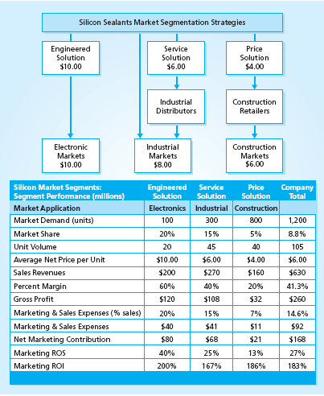

Step 4 – Segment Profitability
Marketing Performance Tool 5.3
Silicon Sealants
How would this segment profitably help segmentation help this company improve sales and profits?
Copyright Roger J. Best, 2012

Slide 18
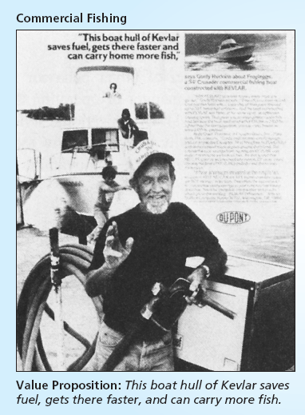
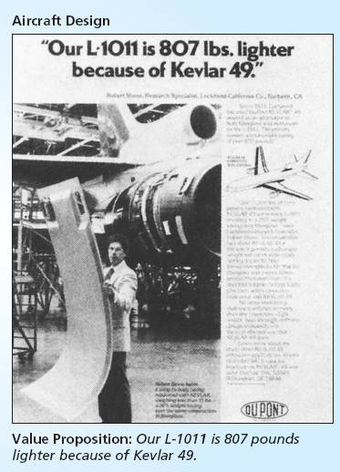
Step 5 – Segment Positioning
MBM6
Chapter 5
Kevlar: Same product, two segment applications and positioning strategies.
Copyright Roger J. Best, 2012

Slide 19
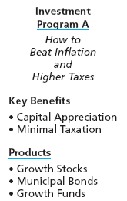
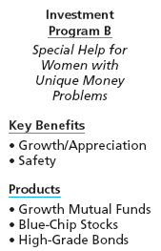
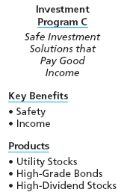



Steps 6 – Segment Acid Test
MBM6
Chapter 5
Copyright Roger J. Best, 2012

Slide 20
Market Segmentation
and Segmentation Strategies
MBM6
Chapter 5
Segmentation
Strategies
In this section we will focus on a variety of market segmentation strategies.
Copyright Roger J. Best, 2012

Slide 21
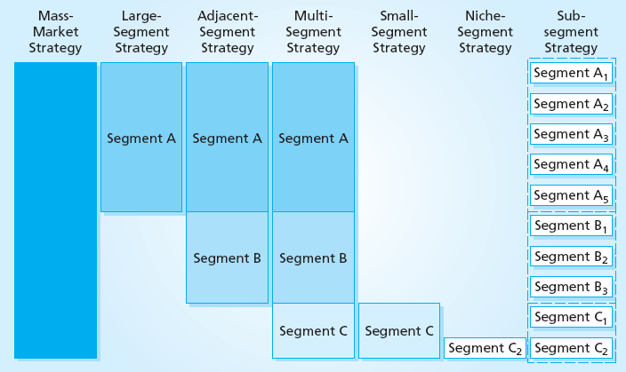
Segmentation Strategies
MBM6
Chapter 5
Why would different banks use different segmentation strategies?
Copyright Roger J. Best, 2012

Slide 22
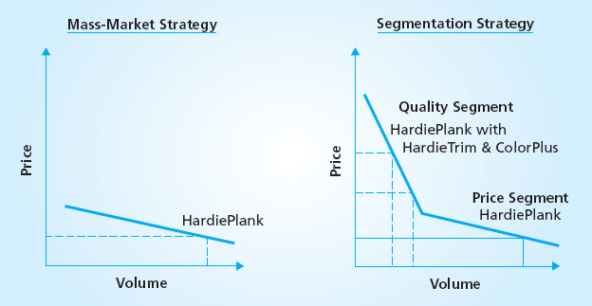
Mass Market vs. Segment Strategy
MBM6
Chapter 5
Why would James Hardie (manufacturer of Handie Plank siding) be more profitable with a segment strategy?
Copyright Roger J. Best, 2012

Slide 23
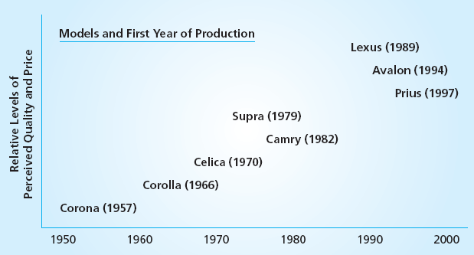
Adjacent Segment Strategy
MBM6
Chapter 5
What was the logic of Toyota’s adjacent segment strategy that started in 1957 at the low end of the price-quality car market?
Copyright Roger J. Best, 2012

Slide 24
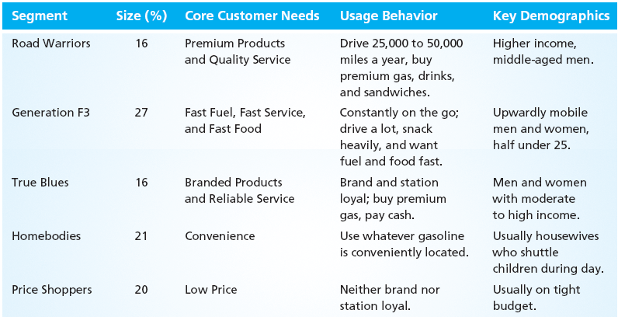
Market Segmentation of Gasoline Market
MBM6
Chapter 5
How would a local gas station select and segment and position its gas station?
Copyright Roger J. Best, 2012

Slide 25
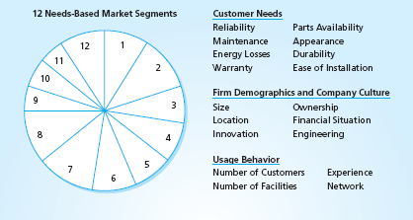
Multi-Segment Strategy
MBM6
Chapter 5
How could this market segmentation with 12 segments help electrical equipment sales personnel improve their sales, and hence, company sales?
Copyright Roger J. Best, 2012

Slide 26
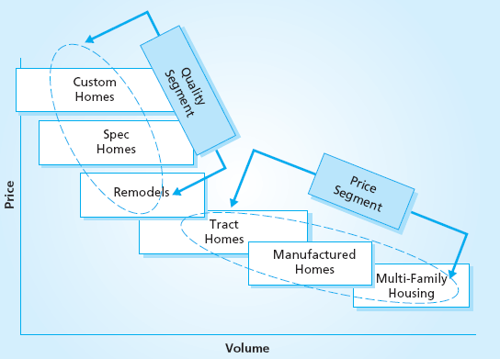
Sub-Segment Strategies
MBM6
Chapter 5
Core segments can be further segmented based on unique needs within a segment. How would this help a company sell its products?
Copyright Roger J. Best, 2012

Slide 27
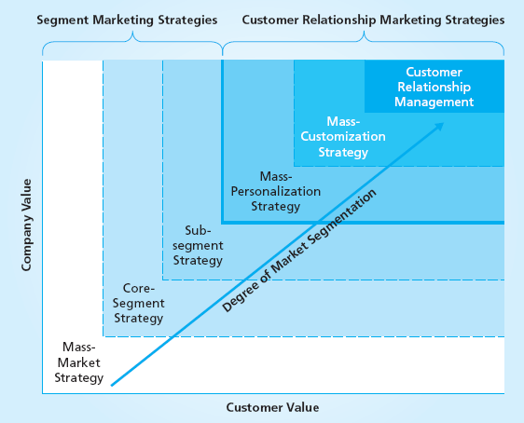
Customer Relationship Marketing
Marketing Performance Tool 5.5
There are
three levels of
Customer Relationship Marketing
Mass Personalization
Mass Customization
Customer Relationship
Management
Copyright Roger J. Best, 2012

Slide 28
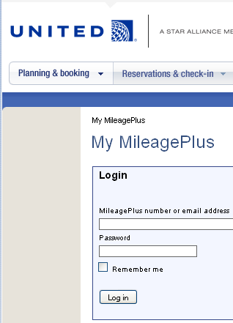
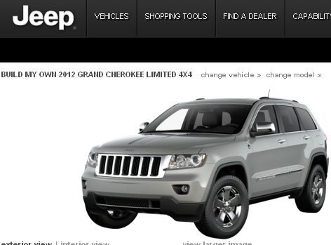

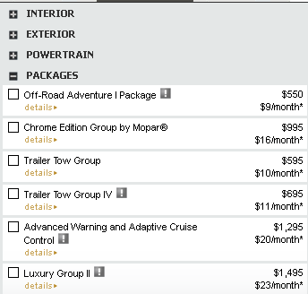

Examples of Customer Relationship Marketing
MBM6
Chapter 5
Mass Personalization (Airline Mileage Programs)
Mass Customization
(Car Manufacturers)
Relationship Marketing
(Financial Services)
Copyright Roger J. Best, 2012

